Slide 1
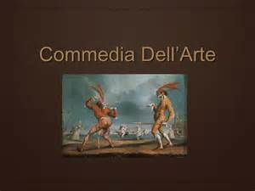

Slide 2
COMMEDIA DELL’ARTE THE BEGINNING OF IMPROVISATION

Slide 3
DEFINITION
Commedia dell'arte is a form of theatre characterized by masked “types” which began in Italy in the 16th century and was responsible for the advent of the actresses and improvised performances based on sketches or scenarios. The closest translation of the name is “ comedy of craft”; it is shortened from commedia dell’arte all’improvviso, or “comedy of the very creative ability of improvisation”.

Slide 4
In spite of its outwardly anarchic spirit, the commedia dell'arte was a highly disciplined art requiring both virtuosity and a strong sense of ensemble playing. The unique talent of commedia players was to improvise comedy around a pre–established scenario. Responding to each other, or to audience reaction, the actors made use of the lazzi (special rehearsed routines that could be inserted into the plays at convenient points to heighten the comedy), musical numbers, and impromptu dialogue to vary the happenings on stage.

Slide 5
Physical Theater Masks forced actors to project their characters' emotions through the body. Leaps, tumbles, stock gags (burle and lazzi), obscene gestures and slapstick antics were incorporated into their acts.

Slide 6
Stock Characters the famous character types can be divided into four main categories:
(1) The Servants or Zanni such as Arlecchino (Harlequin), Pulcinella (Punch), Colombina (Columbine), Scapino (Scapín), Brighella, Pedrolino, Pierrot, and the like;
(2) The Old Men or Vecchi such as the greedy Magnifico (Pantalone), the know-it-all professor (il Dottore), or the stuttering Tartaglia;
(3) The young Lovers or Innamorati with names such as Isabella, Flaminia, or Ortensia (for women) and Flavio, Orazio, Ortensio, or Leandro (for men).
(4) The boasting Captains or Capitani and their female equivalent, the vivacious and oftentimes violent La Signora.

Slide 7
STOCK COSTUMES
Costumes The audience was able to pick up from each character's dress the type of person he was representing. Males would identify themselves with character-specific costumes and half masks. The zanni (precursor to clown) Arlecchino, for example, would be immediately recognizable because of his black mask and patchwork costume.

Slide 8
While the inamorato and the female characters wore neither masks nor costumes unique to that personage, certain information could still be derived from their clothing. Audiences knew what members of the various social classes typically wore, and also expected certain colors to represent certain emotional states. Regardless of where they toured, commedia dell'arte conventions were recognized and adhered to.

Slide 9
MASKS
Masks All the fixed character types, the figures of fun or satire, wore colored leather masks. Their opposites, usually pairs of young lovers around whom the stories revolved, had no need for such devices. Today in Italy handcrafted theater masks are still created in the ancient tradition of carnacialesca.

Slide 10
LANDMARKS
A major landmark in theatre history occurred in Padua, Italy, on February 25, 1545, when Ser Maphio’s troupe of performers signed a letter of incorporation establishing themselves as a “fraternal compagnia.”

Slide 11
SHOW BUSINESS
. Other troupes of this era had similar endeavors, and the business of “show business” was born when artist-entrepreneurs began to create professional models for making a living in the theatre.

Slide 12
WOMEN MAKE A MARK
Another major landmark in theatre history was first confirmed in 1566 when a Commedia performer named Vincenza Armani became the first documented professional actress.
Evidence exists as early as the 1540s that Commedia troupes began to create professional space for female performers, but the late 1560s and 1570s were the Age of the Actress. Isabella Andreini became one of the most famous and sought-after performers in all of Italy and France.
The advent of the actress occasioned a new character type: the male and female Lovers or Innamorati (innamorato, masculine; innamorata, feminine) who became the children of the Old Men.

Slide 13
WOMEN’S MARK
The advent of the actress occasioned a new character type: the male and female Lovers or Innamorati (innamorato, masculine; innamorata, feminine) who became the children of the Old Men.

Slide 14
MIME COMES TO COMMEDIA
ThE male servant played in white face (hence the term “infarinato,” meaning “floured.”) This white-faced comic servant is an ancestor to the white-faced clown of the circus tradition and the modern, white-faced pantomime.

Slide 15
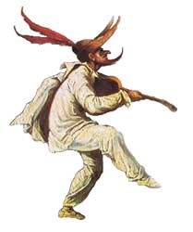
ZANNI

Slide 16
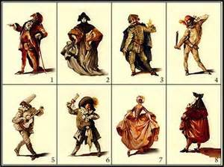
COSTUMES

Slide 17
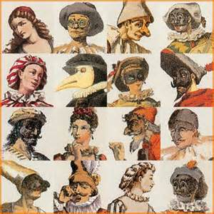
MASKS

Slide 18
Ms. Dean’s web address
www.paula.dean.weeblydcom

