Slide 1
GREEK THEATRE VOCABULARY
550 – 220 BC

Slide 2
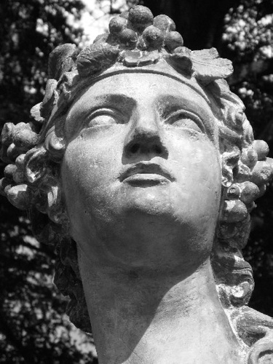
DIONYSUS
GOD OF WINE AND GROWTH. IT IS SAID THAT DIONYSUS DIED IN THE WINTER AND CAME BACK TO LIFE IN THE SPRING. BECAUSE OF THIS BELIEF THE NAME DIONYSUS STANDS FOR NEW LIFE.

Slide 3
TRAGEDY
LITERAL MEANING…GOAT SONG
DEFINITION: A TRAGIC HERO STRUGGLES TO SOLVE A PROBLEM THAT HE IS UNABLE TO SOLVE.

Slide 4
DYTHRAMBS
THESE WERE THE HYMNS OR SONGS SUNG BY THE CHORUS IN HONOR OF DIONYSUS. THEY WOULD FILL IN THE GAPS WITH INFORMATION NEEDED TO KEEP THE STORY GOING.

Slide 5
DIONYSUS FESTIVAL
THESE WERE THE FESTIVALS HELD TO HONOR DIONYSUS. THERE WERE 4 FESTIVALS AT DIFFERENT TIMES OF THE YEAR. THE FESTIVAL HELD IN MARCH HONORING DIONYSUS GREW INTO A PLAY COMPETITION. MANY PLAYS WERE PERFORMED FOR THE HONOR OF BEING VOTED THE BEST SCRIPT. IT WAS REALLY THE FIRST TONY AWARDS. DURING THIS TIME ALL THE BUSINESSES WERE CLOSED FOR THE FESTIVAL.

Slide 6
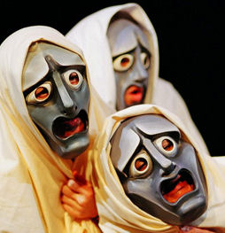
GREEK CHORUS
A COMPANY OF ACTORS WHO COMMENTED (BY SPEAKING OR SINGING IN UNISON) ON THE ACTION IN A CLASSICAL GREEK PLAY.

Slide 7
CHORAL ODES
THE GREEK CHORUS TALKED ABOUT THE THEME OF THE PLAY BY USING METAPHOR, SIMILE, OR ANECDOTE.
EXAMPLE OF AN ODES WOULD BE IN A MUSICAL THE CHARACTERS SOMETIMES BREAK INTO SONG TO SING ABOUT THEIR THOUGHTS ABOUT THE ACTIONS OF THE PLAY.
IN A GREEK TRADGEY EPISODES, THE ONLY CHARACTER WHO CAN COMMENT ON THE ACTION IS THE CHORUS.

Slide 8
TRILOGY
THREE TRAGEDIES CENTERED AROUND ONE THEME

Slide 9
FARCE
A PLAY FULL OF RIDICULOUS EVENTS AND UNREAL SITUATIONS. THEY ALSO CAN BE USED TO POKE FUN AT A GROUP OR AN IDEA OR A BELIEF.

Slide 10
ORCHESTRA AREA
THE AREA IN THE GREEK THEATRE STRUCTURE WHERE THE ACTORS PERFORMED. TODAY WE SAY THIS AREA IS WHERE THE ORCHESTRA IS PLACED DURING A PRODUCTION OF A MUSICAL.

Slide 11
RUINS OF THE ORCHESTRA AREA

Slide 12
SKENE
THE STRUCTURE BEHIND THE ORCHESTRA AREA. THIS IS THE AREA WHERE ACTORS WOULD WAIT TO GO ON AND WHERE VARIOUS PROPS AND MASKS WERE STORED DURING A PRODUCTION.

Slide 13
SKENE

Slide 14
PROLOGUE
A MONOLOGUE OR DIALOGUE PRECEDING THE ENTRY OF THE CHORUS, WHICH PRESENTS THE TRAGEDY’S TOPIC. IT IS NOT A SONG.

Slide 15
PROLOGUE EXAMPLE
TWO HOUSEHOLDS, BOTH ALIKE IN DIGNITY, IN FAIR VERONA, WHERE WE LAY OUR SCENE. FROM ANCIENT GRUDGE BREAK TO NEW MUTINY. WHERE CIVIL BLOOD MAKES CIVIL HANDS UNCLEAN. FROM FORTH THE FATAL LOINS OF THESE TWO FOES, A PAIR OF STAR-CROSS’D LOVERS TAKE THEIR LIFE…

Slide 16
PARADOS
THIS IS THE ENTRANCE SONG SUNG BY THE CHORUS AS THEY ENTER THE OCHESTRA AREA. THIS SONG GIVES BACKGROUND INFORMATION. THIS WOULD HAPPEN AFTER THE PROLOGUE.

Slide 17
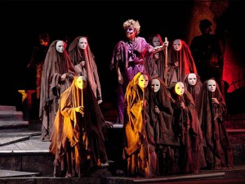
EPISODE
THIS IS THE PARTS OF A PLAY WHERE CHARACTERS PERFORM AND ACT OUT THE STORY OF THE PLAY.

Slide 18
FIRST EPISODE
THIS IS THE FIRST ACT OF THE PLAY. THERE ARE MANY EPISODES WHERE THE ACTORS AND CHORUS CONTINUE TO ACT OUT THE STORY OF THE PLAY.

Slide 19
EXODUS
AS THE CHARACTERS LEAVE, THE CHORUS TELLS US WHAT THEY SHOULD HAVE LEARNED FROM THE STORY.

Slide 20
GREEK ACTORS

Slide 21
THESPIS
According to tradition, in 534 or 535 BC, Thespis astounded audiences by leaping on to the back of a wooden cart and reciting poetry as if he was the characters whose lines he was reading. In doing so he became the world's first actor, and it is from him that we get the word “thespian”.
HE WAS ALSO A PLAYWRIGHT.

Slide 22
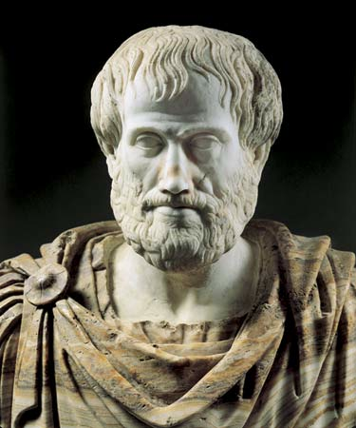
HE INTRODUCE THE PROTAGONIST TO THE STORY.

Slide 23
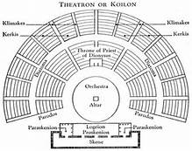
THEATRON
THIS IS THE PLACE WHERE THE AUDIENCE WOULD SIT TO WATCH THE PERFORMANCE OF A GREEK TRAGEDY. IT ALSO MEANS “A SEEING PLACE”.

Slide 24
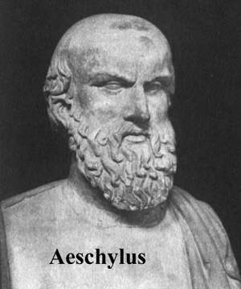
AESCHYLUS
GREEK PLAYWRIGHT WHO ADDED A SECOND ACTOR. THIS INTRODUCED THE ANTOGONIST

Slide 25
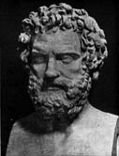
SOPHOCLES
AN ACCOMPLISHED PLAYWRIGHT, HE IS
ALSO CREDITED FOR BECOMING THE
THIRD ACTOR TO PERFORM IN THE
GREEK THEATRE.

Slide 26
THREE TYPES OF PLAYS

Slide 27
TRAGEDY
LITERAL MEANING…GOAT SONG
DEFINITION: A TRAGIC HERO STRUGGLES TO SOLVE A PROBLEM THAT HE IS UNABLE TO SOLVE.

Slide 28
COMEDY
IN GREEK THEATRE THIS NAME WAS GIVEN TO A WIDE RANGE OF PLAYS. IT IS A PLAY WHICH USED HUMOR IN THE TOPIC OF THE HUMAN BEING AND THEIR STRUGGLES.

Slide 29
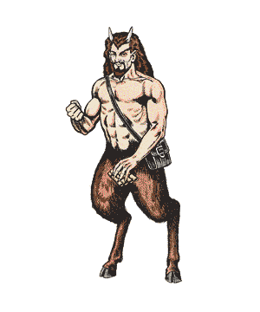
SATYR
GREEK MYTHOLOGY CHARACTER WHO IS HALF-MAN AND HALF-GOAT WHO DWELLS IN THE WOODS AND HAS THE BODY OF A MAN AND THE EARS, HORN, AND LEGS OF A GOAT.

Slide 30
SATYR PLAYS
SAME STRUCTURE OF THE TRAGEDY BUT THE CHORUS WOULD BE DRESSED AS SATYRS AND WOULD MAKE HUMOROUS COMMENTS ABOUT THE CHARACTERS AND THEIR SITUATIONS. THEY WOULD BE LOUD AND AT TIMES BAUDY AND RUDE AS THEY POKED FUN OF THE PLAY’S THEME AND CHARACTERS.

Slide 31
LATEST FASHION IN GREEK THEATRE COSTUMES
WHAT THE GODS AND CHORUS ARE WEARING.

Slide 32
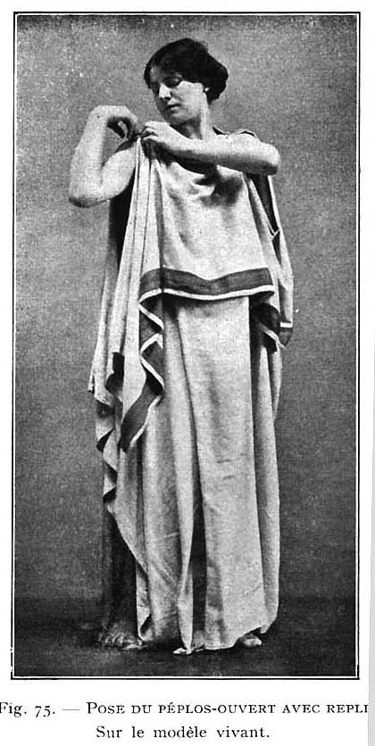

Slide 33
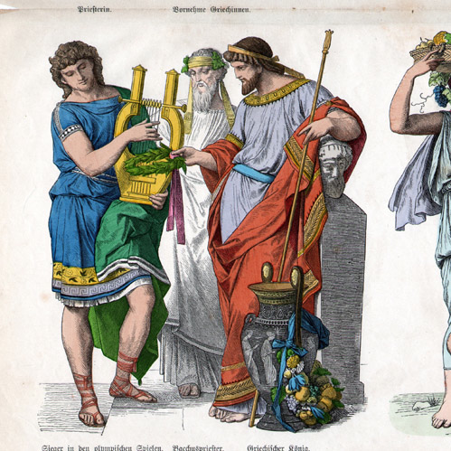

Slide 34
MASKS
BECAUSE MEN PLAYED WOMEN AND BECAUSE THERE WERE ONLY THREE ACTORS, GREEKS WORE MASKS TO DESTINQUISH BETWEEN CHARACTERS AND GENDER.
GENERALLY THE CHORUS WORE THE SAME MASKS THROUGHOUT THE COURSE OF THE PLAY BECAUSE THEIR CHARACTER DID NOT CHANGE.

